Slide 1
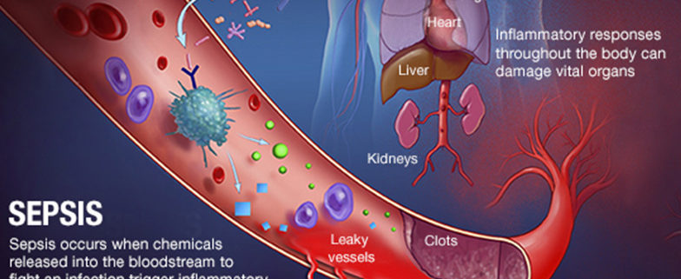
SEPSIS
Major Richard Grainger CCFP(EM)
Emergency Physician 11/12 Field Amb
*adapted from Lt(N) Yoon, Maj Armstrong

Slide 2
Outline
Definitions
Diagnosis
Sources
Management
Pressor Review

Slide 3
INTRO
Chance that any infection will develop into sepsis
Sepsis must have EARLY recognition
Sepsis must have EARLY treatment
Sepsis management must start in the pre-hospital environment

Slide 4
Definitions
Continuum: infection and bacteremia to sepsis and septic shock
Definitions continue to evolve
Early Sepsis – No clear definition but useful to identify those at risk of progressing to sepsis and septic shock
Infection – invasion of normally sterile tissue by organisms resulting in infectious pathology
Bacteremia – presence of viable bacteria in the blood

Slide 5
Definitions
Sepsis – life threatening organ dysfunction caused by a dysregulated host response to infection. Must have:
Organ dysfunction
Presence of Infection
Septic Shock
Vasodilatory/distributive shock
Sepsis + requirement for vasopressors to maintain map >65 (lactate >2) despite adequate fluid resuscitation

Slide 6
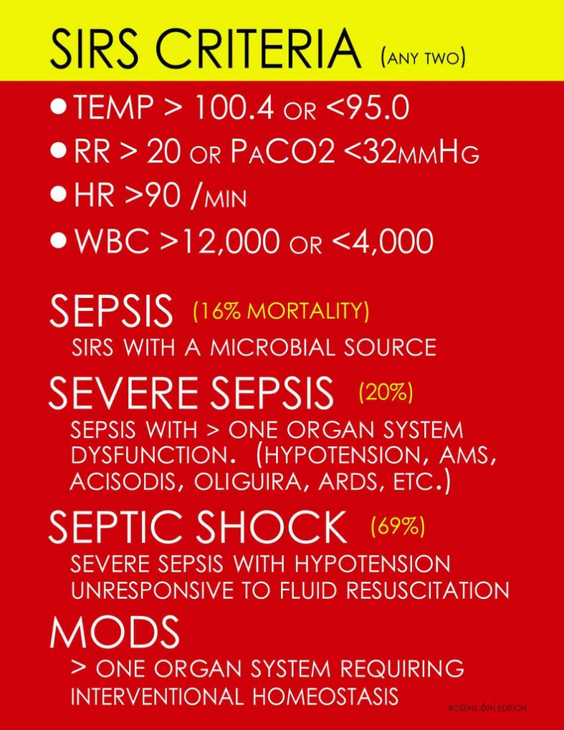

Slide 7
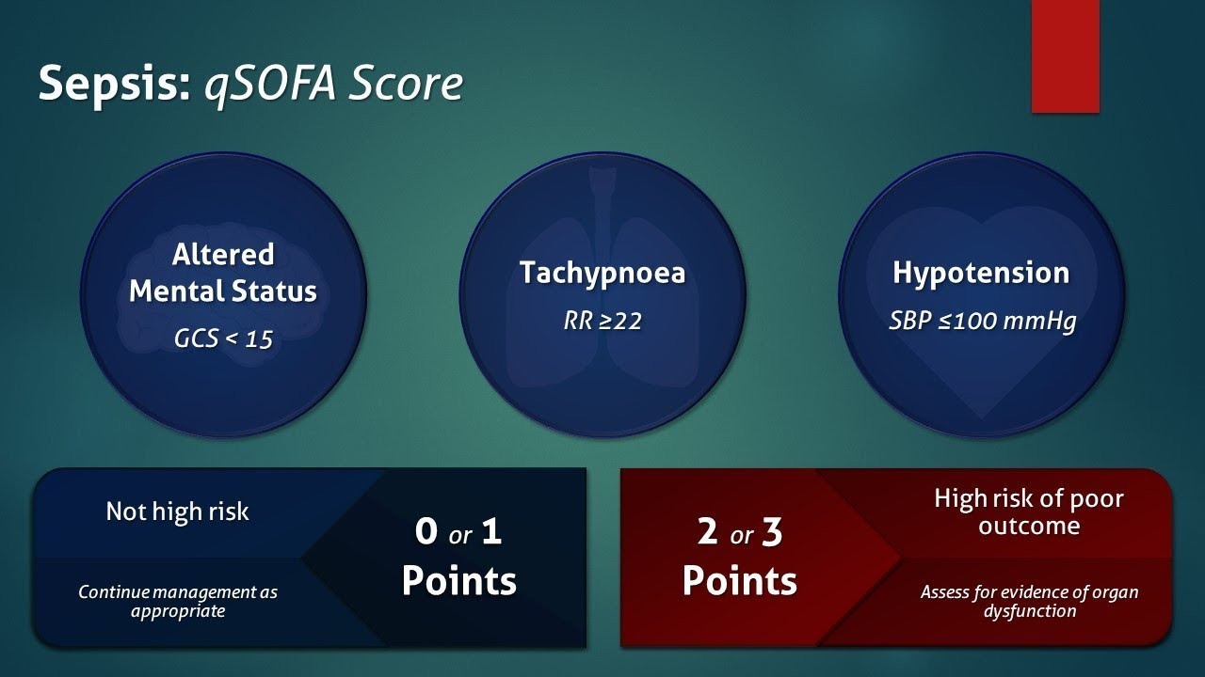
QUICK SEPSIS ORGAN FAILURE ASSESSMENT (no longer recommended as single screening tool)
Bottom line: Infection + organ dysfunction = sepsis
Notes:
Derived for patients suspected of having an infection to be prognositic indicator of mortality, not a screening tool to ID infection and dx sepsis.
Limited prospective validation though one study did find it predicted mortality more accurately than SIRS criteria

Slide 8
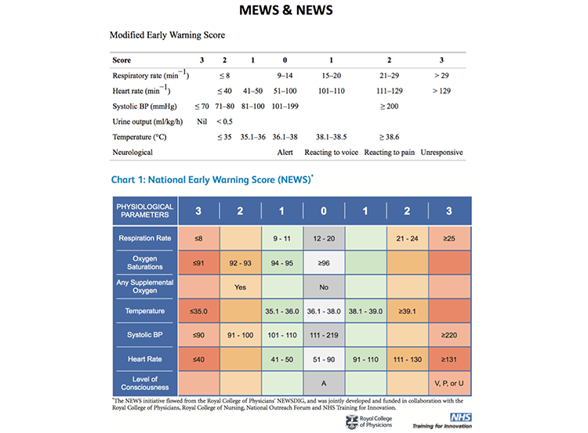
Modified Early Warning System/National Early Warning Score

Slide 9
OTHER SEPSIS MARKERS = ORGAN DYSFUNCTION
Urine dipstick - if + protein = high chance that it is due to sepsis
Leukocytosis (>12) or leukopenia (<4)
Increasing lactate (> 2.0 with suspected infection increase likelihood of sepsis dx)
increasing creatinine (within the first 72 h of care) and lowering eGFR is also a predictor (64%) of sepsis
Increasing LFTs, decreasing platelets (initially increase)
Oliguria (<0.5ml/kg/hour)
In sepsis, the kidneys get hit!

Slide 10
SOURCES OF INFECTION
Central Nervous System – meningitis, encephalitis
Head and neck - eg. deep space neck infections
Lungs – pneumonia
Intra-abdominal or hepato-biliary origin
GU – sexually transmitted infections, PID
Urine – bladder or kidney infection
Skin and soft tissue infection
Unknown?

Slide 11
TIME IS OF THE ESSENCE
End-organ damage and increased mortality results when:
Delay in recognizing sepsis
Delay in obtaining vascular access
Delay in providing hemodynamic support – i.e. septic shock – hypotension
Delay in administering antibiotics
Delay in transport to higher level of care

Slide 12
SEPSIS TREATMENT
IV Fluids – 30 ml/kg in the first 3 hours – balanced crystalloid first (Ringers Lactate)
get MAP > 65 mmHg
Lactate – follow lactate levels and falling levels to <4.0 mmol/L is a good thing
Antibiotics – quickly, but get blood cultures first (if you have a lab!)
Pressor - Norepinephrine first choice, but if none around, epinephrine
Normoglycemia – Both hypoglycemia and hyperglycemia BAD.
Hydrocortisone – 200 mg IV for patients where no response with IV fluid boluses
If Diarrhea & Vomiting – replace GI fluid losses in maintenance IVF

Slide 13
EMPIRIC ANTIBIOTIC CHOICES
Unknown - Ceftriaxone 2gm IV q24h and metronidazole 500 mg IV q12h
Pneumonia - Ceftriaxone 2gm IV q24h and azithromycin 500 mg IV q24h
UTI - Ceftriaxone 2gm IV q24h
STI (chlamydia and/or gonorrhea) -> PID Cefoxitin 2 gm q6h + Doxycycline 100 mg po/iv q12h
Skin/Soft Tissue - Clindamycin 300-600 mg IV q6h
Intra-abdominal - Ceftriaxone 2gm IV q24h and metronidazole 500 mg IV q12h
Central Nervous System - Dexamethasone 0.15 mg/kg IV q6h and Ceftriaxone 2gm IV q24h and ampicillin 2g IV q4h and acyclovir 10 mg/kg IV q8h

Slide 14
VASOPRESSORS
Improves Cardiac Output (HR + SV) by acting on alpha and beta adrenergic receptors.
Phenylephrine: 0-300 mcg/min (push dose 100-200 mcg)
Norepinephrine: 0-30 mcg/min (0.01-0.5 mcg/kg/min)
Epinephrine: 0-20 mcg/min

Slide 15
NorEpinephrine 1st Choice
Septic shock
Cardiogenic shock
Neurogenic shock
Epinephrine First Choice for:
Anaphylactic shock
Epinephrine (0.3-0.5 mg IM and/or 2-10 ug/min infusion)
Glucagon 1 mg IV if beta-blocked
Second choice Pressor for:
Septic shock
Cardiogenic shock
Neurogenic shock
Phenylephrine for:
Push dose pressor
Commonly used in intubations pre/post
Used to buy time to set up Norepinephrine infusion

Slide 16
EPI PUSH DOSE
Options: Dilute in 1L of NS or 100 ml NS
1 mg epi (does not matter if 1:1000 or 1:10,000) = 1000 mcg epi
1000 ml NS => 1000 mcg in 1000 ml = 1 mcg/ml of Epi
100 ml NS => 1000 mcg in 100 ml = 10 mcg/ml

Slide 17
IF PRESSOR GOES INTERSTITIAL
Stop the infusion
Warm compresses on the tissue to promote vasodilation
If available:
Phentolamine (alpha blocker) – inject 5-10 mg (diluted in 10 mL 0.9% NaCL) into extravasation (use the interstitial catheter that is already in the right spot)
As soon as possible within 12 hours of the extravasation

Slide 18
SUMMARY
RECOGNITION
Early Fluids and Abx
Pressors if needed
Extended care > Evac> HLC

Slide 19
ADDITIONAL RESOURCES
Surviving Sepsis Campaign (SSC) | SCCM
SCCM App

Slide 20
QUESTIONS?

